Slide 1


Evaluation and understanding text-based stock price prediction models
이여진 연구원
2017년 06월 07일

Slide 2
Paper Info
Title : Evaluating and understanding text-based stock price prediction models
2. Authors : Enric Junque de Fortuny, Tom De Smedt, David Martens,
Walter Daelemans
3. Published in : Information Processing & Management 50(2) · March 2014

Slide 3
Abstract & Introduction
Discuss some of the (dis)advantages of the most widely used performance metrics.
Design novel stock price prediction models based on state-of-the-art text-mining techniques.
Contribution 1. Build empirical models to try to counter-act the validity of the two theories (efficient market hypothesis, Random walk Theory) based on the fact that humans do not always act rationally.
Contribution 2.Use different evaluation metrics and show how the model can be used as a decision support tool.

Slide 4
Evaluation of empirical models
Most of the metrics do not give an accurate representation of the usefulness of the trading model.
One can only gain insights into the validity of a previously constructed model by combining various additional evaluation methods.
<evaluation methods>
1. Accuracy
Popular evaluation metrics.
Measures the percentage of correct predictions out of the total amount of prediction made.
Drawback : difficult to assert whether the built models are valid due to the fact that the data in the test set is generally not uniformly distributed.
Example
<Premise>
1. trading model always predict class 1
2. Target label contain 70% class 1 examples, 30% class 2 examples.
<Conclusion>
Accuracy would be 70%

Slide 5
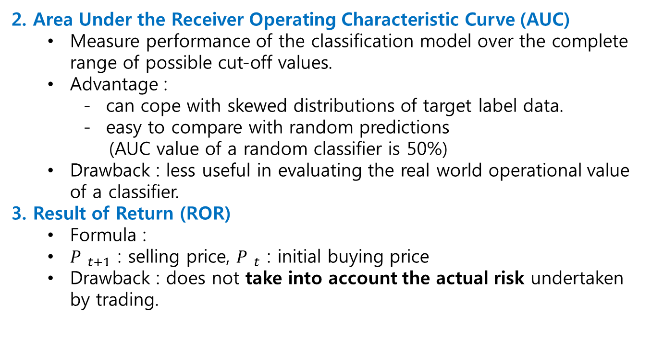
Evaluation of empirical models
2. Area Under the Receiver Operating Characteristic Curve (AUC)
Measure performance of the classification model over the complete range of possible cut-off values.
Advantage :
can cope with skewed distributions of target label data.
easy to compare with random predictions
(AUC value of a random classifier is 50%)
Drawback : less useful in evaluating the real world operational value of a classifier.
3. Result of Return (ROR)
Formula :
${P }_{t+1}$ : selling price, ${P }_{t}$ : initial buying price
Drawback : does not take into account the actual risk undertaken by trading.
Trading rule
- Buy at time t when the model predicts the price is likely to go up within some time frame, lag t+l.
- Sell the stock at time t+l.

Slide 6
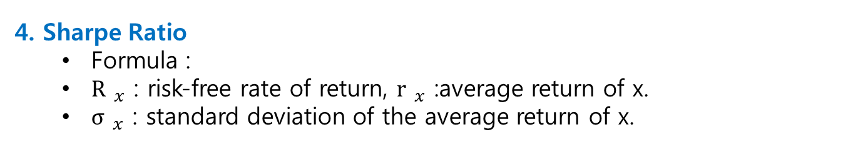
Evaluation of empirical models
4. Sharpe Ratio
Formula :
${\text{R} }_{x}$ : risk-free rate of return, ${\text{r} }_{x}$ :average return of x.
${\text{σ} }_{x}$ : standard deviation of the average return of x.

Slide 7
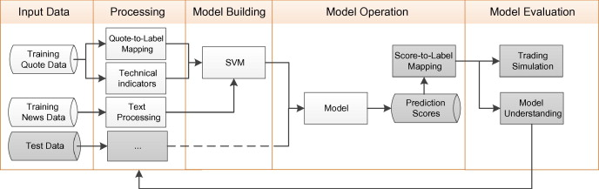
Methodology
Fig. The main set-up of the model learning, operating and evaluation procedure.
Input Data
Stock tick data (quote data), stock news data
Processing
Two types of features : technical indicators, text-related features.
Target : quote-to-labeled data.
Model Building (SVM)

Slide 8
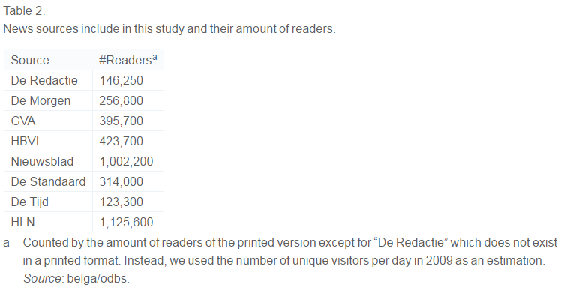
Input Data
Stock news data
1) Acquisition
Corpus from 671,751 articles published in on-line versions of all major Flemish newspapers in 2007 until March 2012.
Articles gathered using a custom web-crawler
Query keywords : organization name
Reduce the scope of the data to include only below part of the article. (3 cases)
Include only the headline. (Title)
Use all textual data of the article (Full Text)
Use only textual data in the same paragraph as the first occurrence of the keyword. (Paragraph)

Slide 9
Input Data
2) Preprocessing
Convert to canonical form
Delete stop-words
Build a dictionary(bag-of-words) containing all of words contained in corpus. -> documents d can be represented as a bag-of-words.
Make tfidf matrix.
Tfidf(t,d,D) = tf(t,d) x idf(t,D)
Tf : term-frequency
Idf : inverse document frequency
Calculate sentiment polarity
calculate the polarity(positive or negative) of each adjective that occurs in the input text with scores between +1.0 and -1.0.

Slide 10
Input Data
2. Technical indicators
Relative Strength Index (RSI)
2) Williams %R
3) Psychological Line (PSY)
4) The Bias Indicator

Slide 11
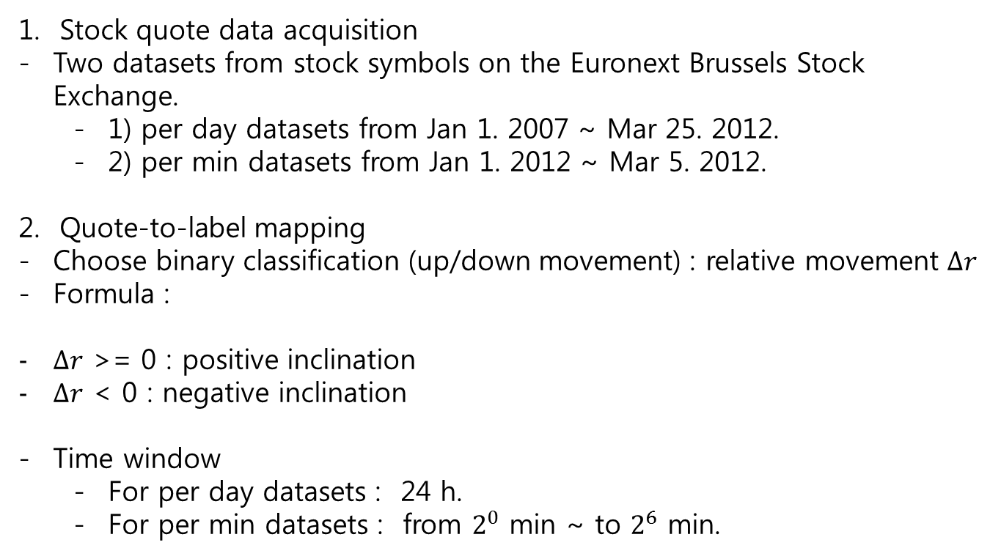
Target Data
Stock quote data acquisition
Two datasets from stock symbols on the Euronext Brussels Stock Exchange.
1) per day datasets from Jan 1. 2007 ~ Mar 25. 2012.
2) per min datasets from Jan 1. 2012 ~ Mar 5. 2012.
Quote-to-label mapping
Choose binary classification (up/down movement) : relative movement $∆r$
Formula :
$∆r$ >= 0 : positive inclination
$∆r$ < 0 : negative inclination
Time window
For per day datasets : 24 h.
For per min datasets : from $2^{0}$ min ~ to $2^{6}$ min.

Slide 12
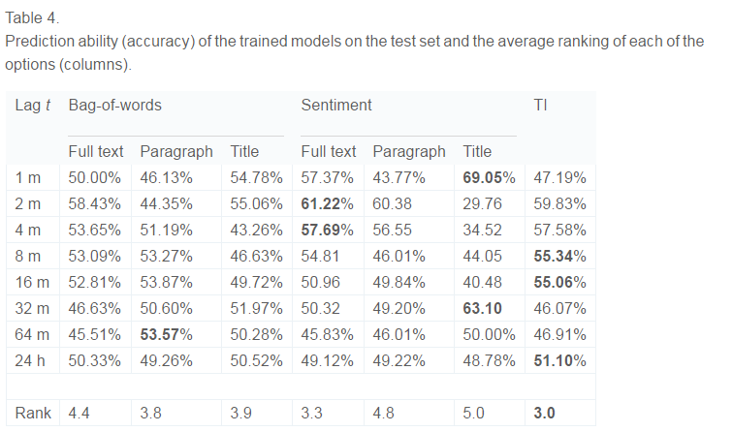
Results – Individual model
Accuracy
No clear winning design choice when looking at the accuracies.
* Lag t example : buy and sell after 1 minute
(it means the price will increase during the timeframe 1 minute)

Slide 13
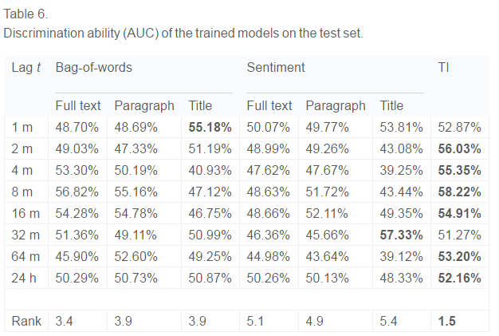
Results – Individual model
2. Area under curve (AUC)
It is not always possible to build a model that performs better than random classifier (AUC of random classifier : 50%).
The technical indicators perform very well, useful for predicting stock price behavior.
Sentiment results are inconsistent and often underperform as compared to the bag-of-words.

Slide 14
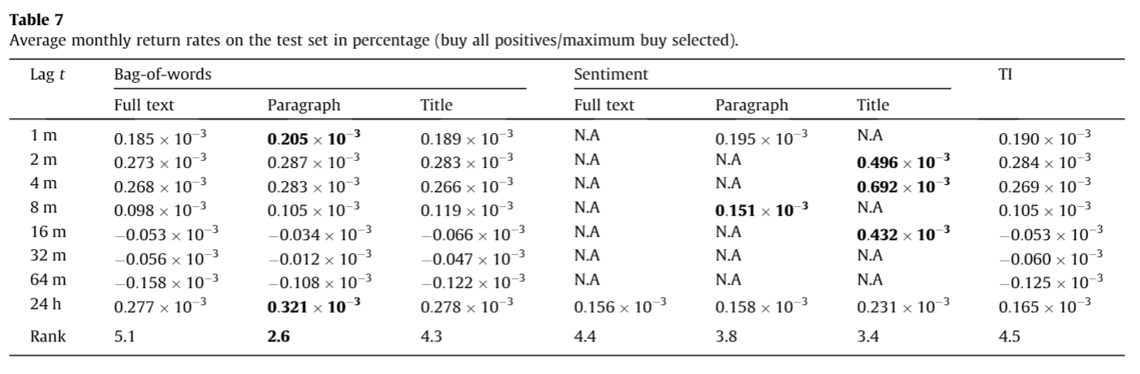
Results – Individual model
3. Rate of return
N.A means that the model did not decide to buy any of the stock.
All short trading time span systems (<= 8m) performed positively.
B.C given a conscious and informed trader, it is reasonable to assume that the bulk of these actions should be visible in the first minutes after the appearance of the news article.

Slide 15
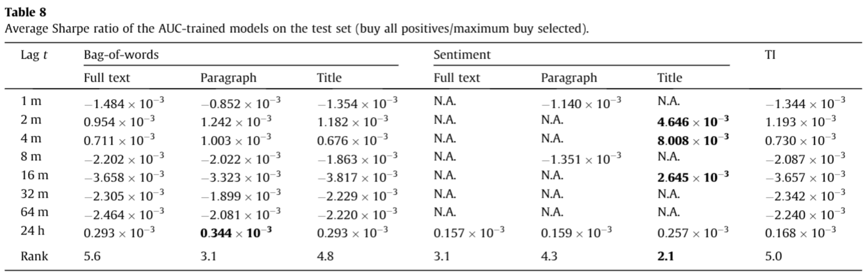
Results – Individual model
4. Share Ratio

Slide 16
Results – Hybrid model
5. Hybrid model
- Build a hybrid system that includes all three of the previous types of input variables.
Input Variables :
1) for per-min settings (90)
3 time windows (week, half hour, 5min) X
5 technical indicators X
3 document contexts (full, paragraph, title) X
sentiment scores X
bag-of-words scores
2) for per-day settings (30)
3 document contexts (full, paragraph, title) X
sentiment scores X
bag-of-words scores

Slide 17
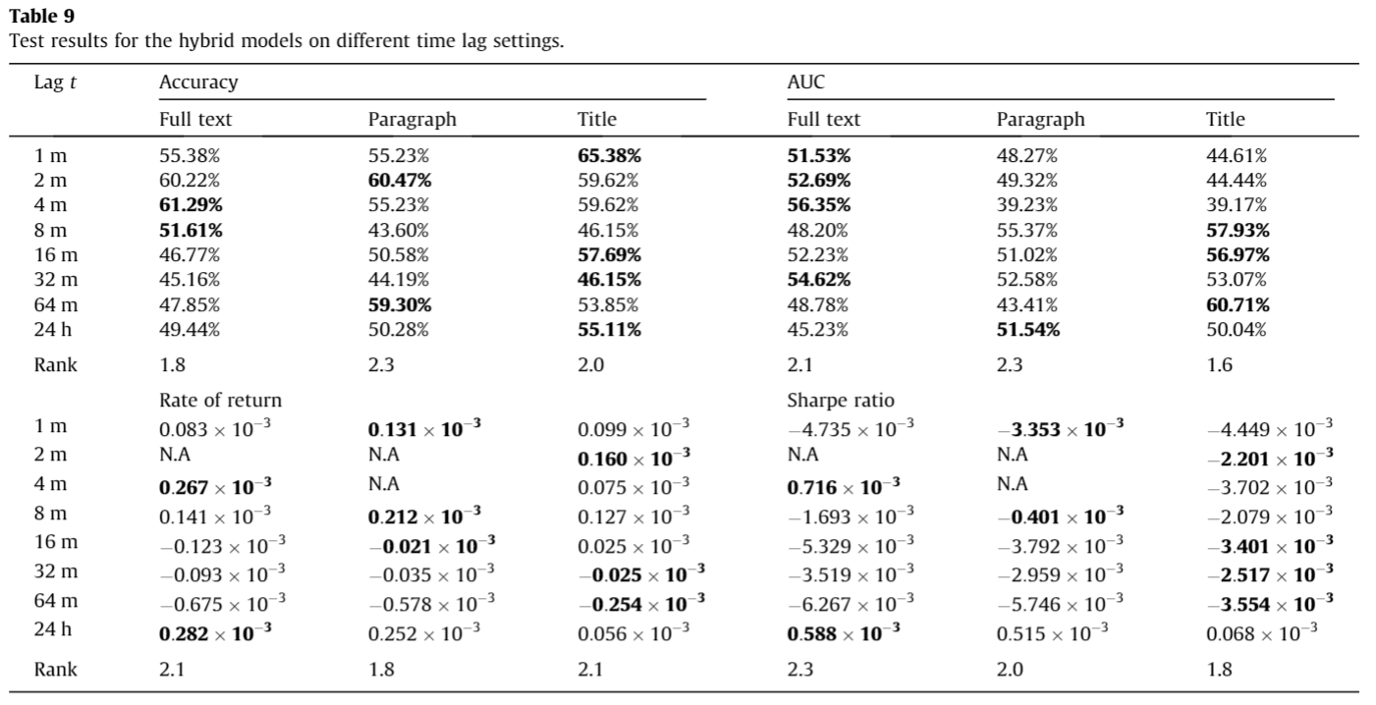
Results - Hybrid model
5. Hybrid model
In terms of the accuracy and AUC, the hybrid model roughly
shows the same behavior.
- In terms of return rates and Sharpe ratio, the models reach some high levels, but this is countered by the fact that some of the built models compare equal or slightly worse than the individual models.

Slide 18
감사합니다.

